Slide 1
Elevate-Labs Devops PROJECT
Title: Netdata Monitoring on Ubuntu EC2

Slide 2
CONTENTS
Objective
Tools
Implementation Steps
Install Docker
Deploy Netdata with Docker
Access Netdata Dashboard

Slide 3
INTRODUCTION OBJECTIVE
Deployed Netdata, a lightweight, open-source monitoring tool, on an AWS EC2 instance running Ubuntu 22.04 to monitor system and application performance metrics. Documented the process for submission as part of a DevOps internship task.

Slide 4
TOOLS
AWS EC2: Ubuntu 22.04 LTS (t2.micro)
Docker: Container runtime for deploying Netdata
Netdata: Real-time performance monitoring tool
GitHub: Repository for logs and documentation

Slide 5
Implementation Steps
1. 🚀 Launch EC2 Instance
Created an Ubuntu 22.04 LTS instance.
Security group configuration:
Port 22 – SSH
Port 80 – HTTP
Port 19999 – Netdata Dashboard
Connected via SSH
ssh -i task7-key.pem ubuntu@public-ip

Slide 6
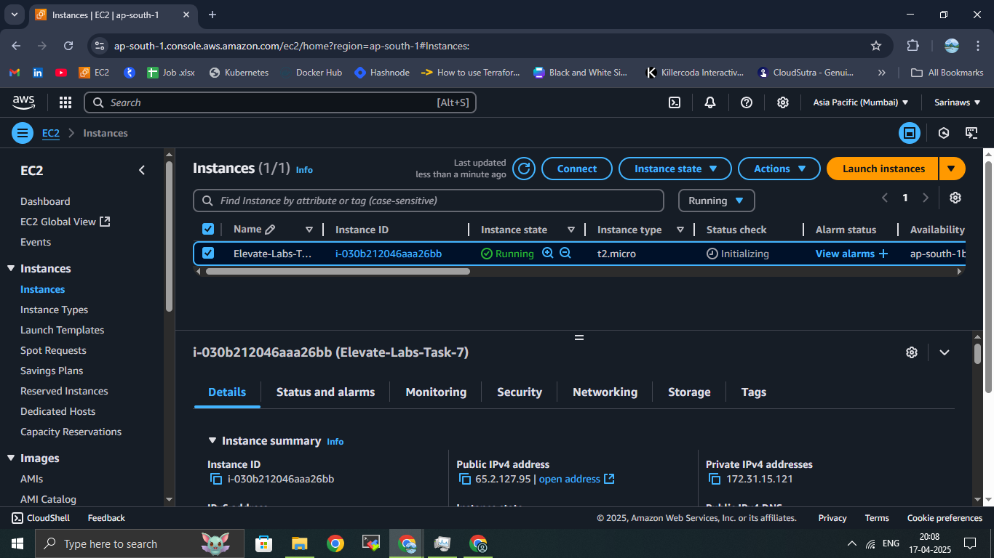
Creating an Amazon EC2 instance

Slide 7
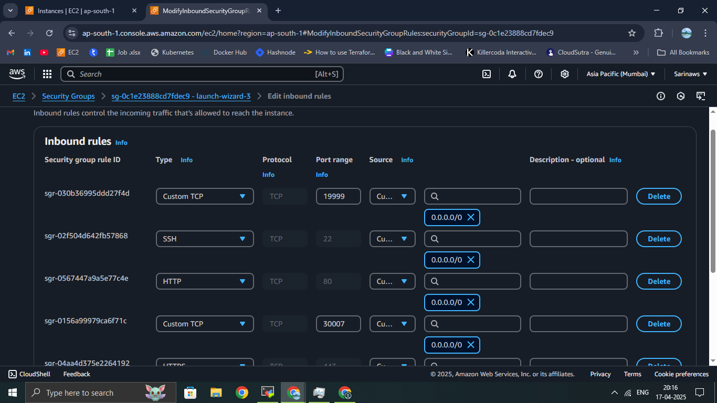
Security Groups

Slide 8
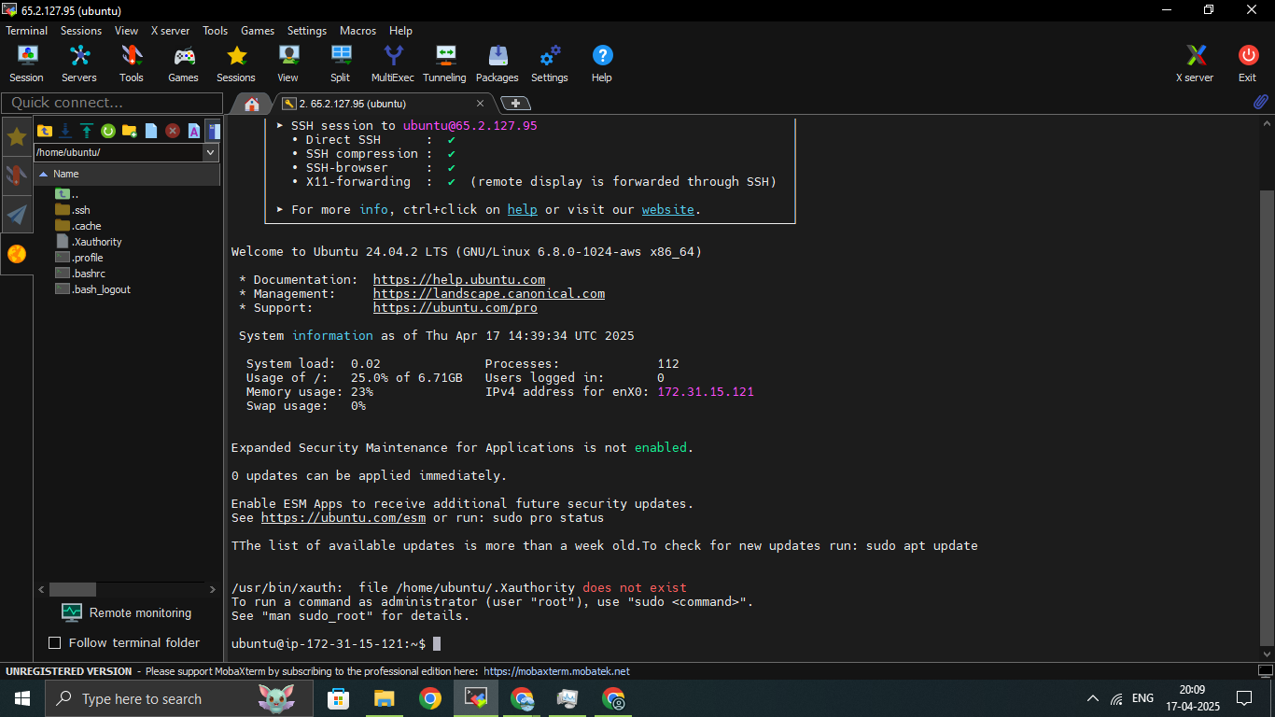
Connected via SSH

Slide 9
2. Installed Docker
Update system
sudo apt update && sudo apt upgrade -y
Install Docker
sudo apt install -y docker.io
Start and enable Docker
sudo systemctl start docker && sudo systemctl enable docker
Add user to Docker group
sudo usermod -aG docker ubuntu

Slide 10
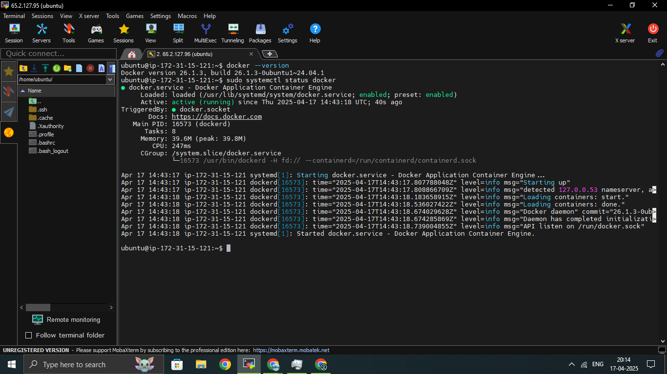
Docker status

Slide 11
3. Deployed Netdata
Run Netdata container
docker run -d --name=netdata -p 19999:19999 netdata/netdata
Verify container status
docker ps

Slide 12
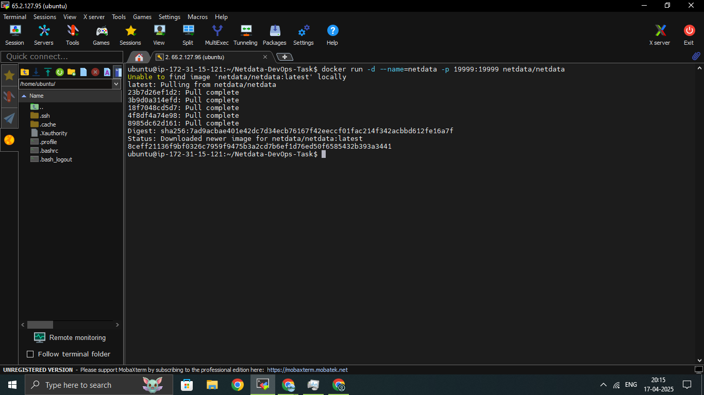
Deployed Netdata

Slide 13
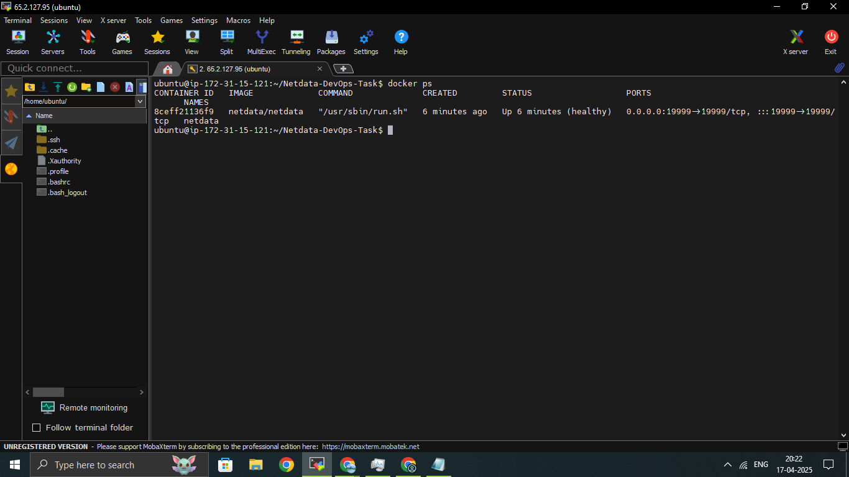
Container status

Slide 14
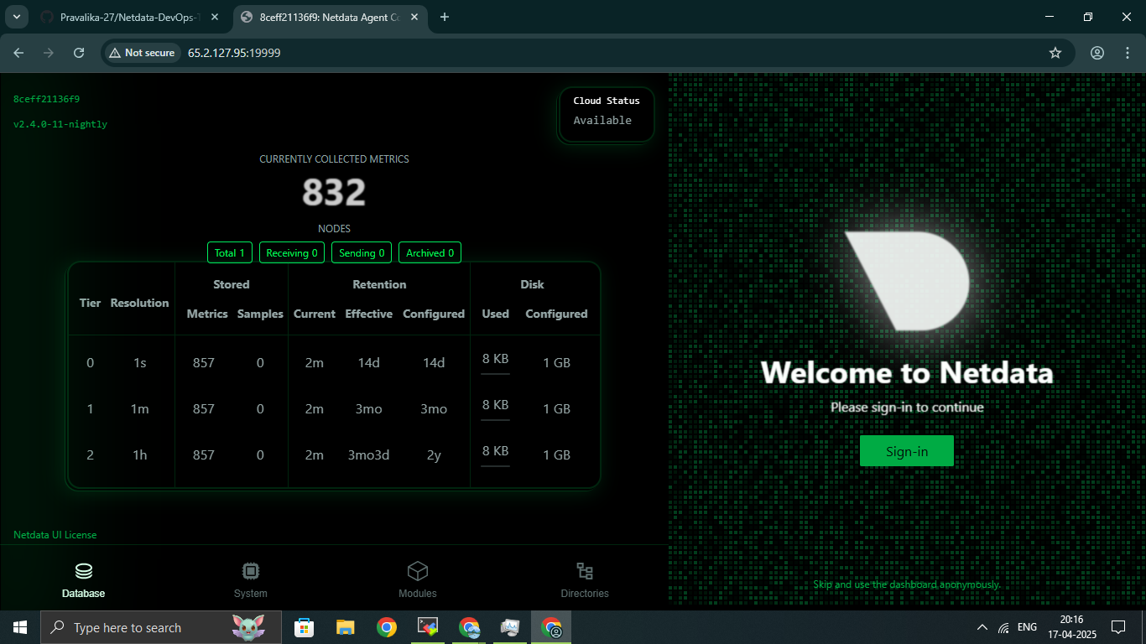
Netdata Dashboard

Slide 15
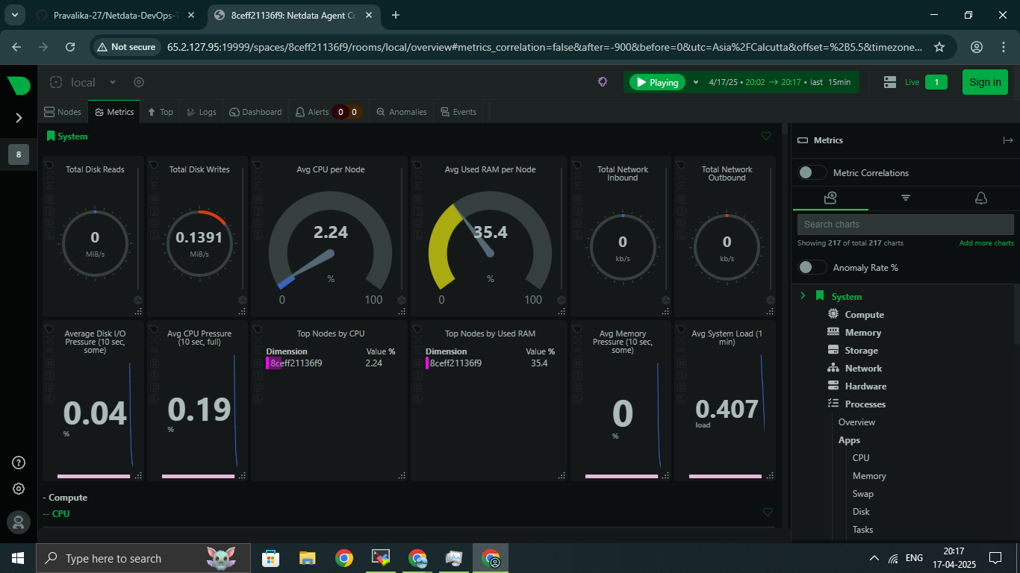
Monitored Metrics

Slide 16
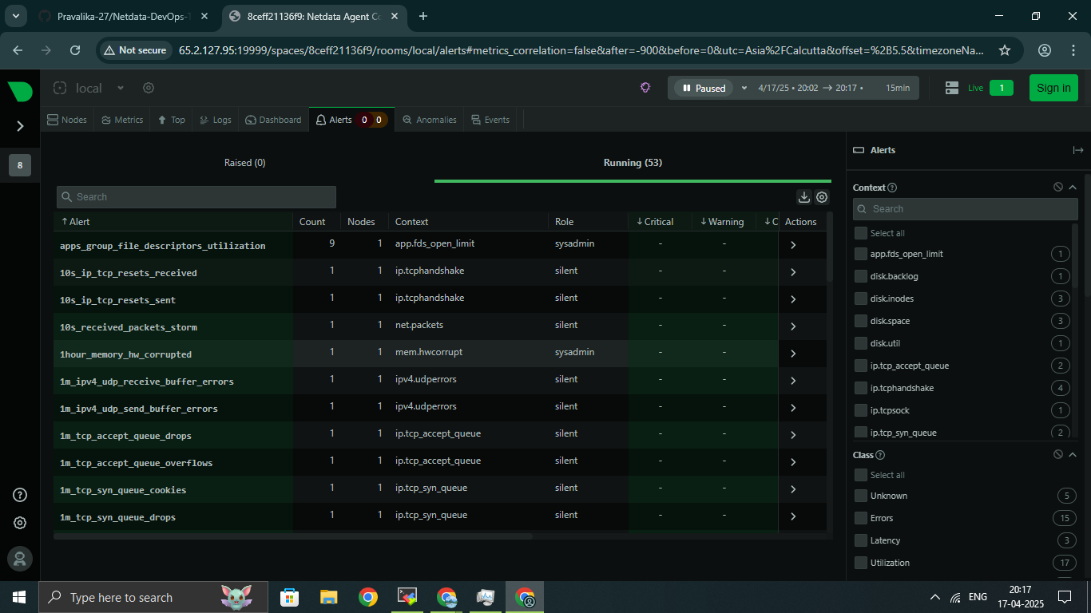

Slide 17
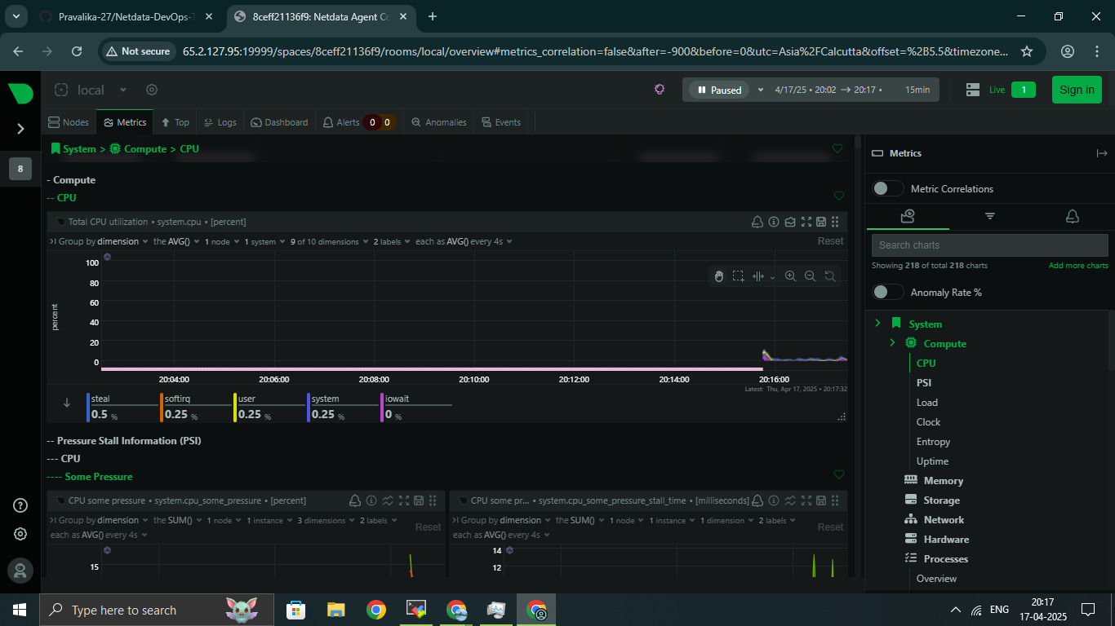
CPU Utilization

Slide 18
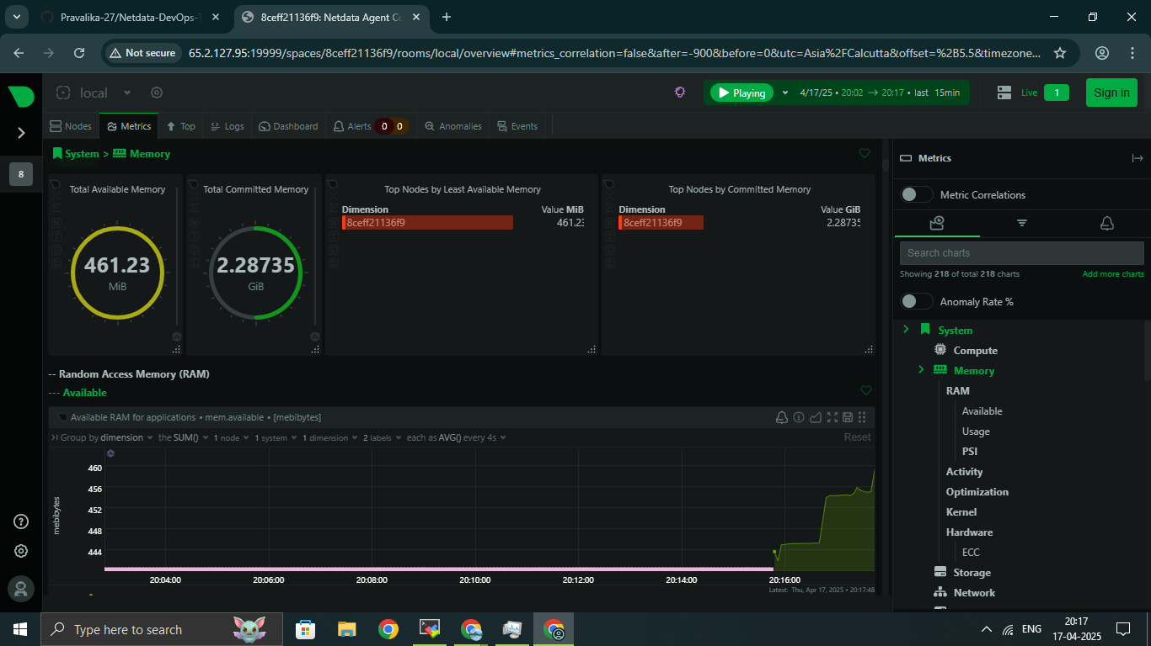
Memory Usage

Slide 19
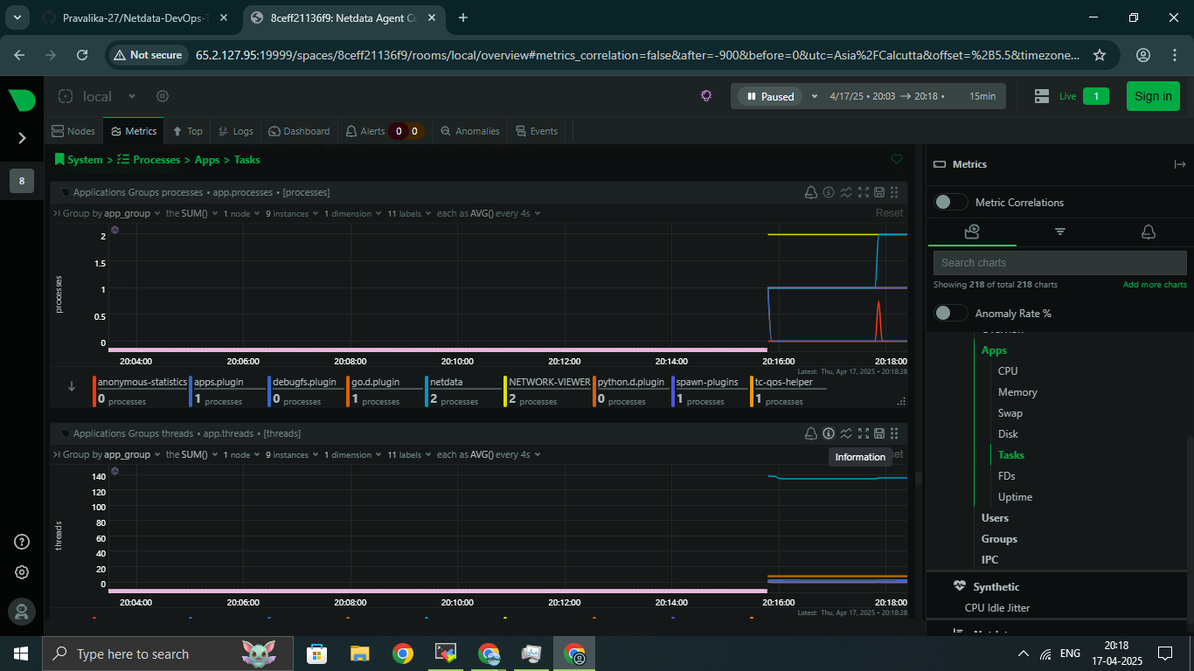
Disk I/O

Slide 20
Conclusion
Successfully deployed Netdata on an Ubuntu EC2 instance. Verified real-time monitoring of CPU, memory, disk I/O, and Docker metrics through the web dashboard.

Slide 21


